Slide 1
Deadwood Presentation Keegan Mangahas

Slide 2
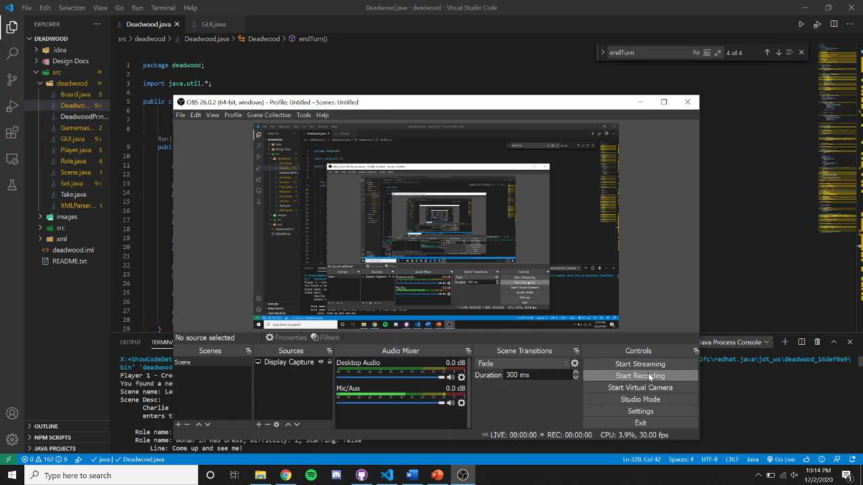

Slide 3
Object-Oriented Techniques
Abstract Classes
Communication Cohesion
Sequential Cohesion
Content Coupling
External Coupling

Slide 4
Design Patterns
Singleton
Adapter
Observer

Slide 5
Challenges
Time consuming
Learning Java Swing while implementing it
Changing classes based on object-oriented practices we learned through the course

Slide 6
Takeaways
Learning good design practices through use
Time management
Satisfaction

